Slide 1




NEXT GEN EMPLOYABILITY PROGRAM
Creating a future-ready workforce
Team Members
College Name
Student Name : DURGADEVI S (513521104014)
Student ID : au51352104014
ANNAI MIRA COLLEGE OF ENGINEERING AND TECHNOLOGY

Slide 2

CAPSTONE PROJECT SHOWCASE
Project Title
Building Bus Reservation System using Python and Django
Abstract | Problem Statement | Project Overview | Proposed Solution | Technology Used | Modelling & Results | Conclusion

Slide 3
Abstract
The Bus reservation system is a software application designed to facilitate the booking of bus tickets by passengers via online
It allows users to search for available bus routes, select seats, make payments, and receive confirmation of their bookings.
The system typically includes features for managing bus schedules, seat availability, fare calculation, and cancellations.
Additionally, it may offer functionalities such as ticket cancellation, passenger information management, and integration with other transportation services.
Overall, the system aims to streamline the process of bus ticket booking and improve the efficiency of bus operations.

Slide 4
Problem Statement
The current process of booking bus tickets is often cumbersome and inefficient, leading to several pain points for both passengers and bus operators. Some of the key issues include:
1. Limited Accessibility
2. Lack of Real-Time Updates
3. Inefficient Seat Management
4. Payment Hassles
To address these challenges, there is a need for a comprehensive bus reservation system that streamlines the booking process, enhances accessibility to information, improves seat management, provides real-time updates, and offers secure and convenient payment options.
Such a system would not only improve the overall experience for passengers but also increase operational efficiency for bus operators.

Slide 5
Project Overview
In-order to have an efficient Bus Management System, I have came up with this project “BUS RESEVATION SYSTEM”.
This project is built with the help of Django, Python, Bootstrap and other necessary frontend and backend tools.
It aims to provide the consumers with an easier User Interface that comprises of Login Page, Finding bus, Booking, Cancellation entities.
A user needs to register himself to access this Bus Reservation System.
Users can find the buses for specific routes with timings based on their requirements. If buses are found, it enables them for booking, if not it notifies them with unavailability message.
After booking a booking form will be generated that contains details of booking.
User can cancel their booking using “Booking ID” and find other buses for booking.
In a nutshell, this project focuses on efficient management of user requirements for either booking or cancelling a bus

Slide 6
Proposed Solution
.
User Registration: The system allows users to create accounts by providing necessary details such as name, contact information, and login credentials.
Route Management: Administrators manage routes by defining origins, destinations, stopovers, and schedules. Each route is associated with specific buses and departure times.
Bus Management: Bus details such as bus number, type, seating capacity, and amenities are stored in the system. Administrators can add, edit, or remove buses as needed.
Seat Allocation: The system manages seat allocation for each bus, allowing passengers to select seats based on availability and preferences during the booking process.
Booking Process: Passengers search for available routes, select desired departure and arrival locations, choose travel dates, and view available buses and seat options. They then proceed to book their tickets by providing passenger details and making payment.

Slide 7
Payment Gateway Integration: The system integrates with payment gateways to facilitate secure online transactions. Passengers can pay for their bookings using credit/debit cards, mobile wallets, or other accepted payment methods.
Ticket Generation: Upon successful payment, the system generates electronic tickets containing essential details such as booking ID, passenger names, seat numbers, journey details, and QR codes for validation.
Confirmation and Notifications: Passengers receive booking confirmation emails or SMS notifications containing their ticket details and journey information. They may also receive reminders or updates regarding their upcoming trip.
Cancellation and Refunds: The system allows passengers to cancel their bookings within a specified timeframe, subject to cancellation policies. Refunds are processed automatically, and passengers receive notifications regarding the refund status.
Admin Dashboard: Administrators have access to a dashboard where they can monitor bookings, manage routes and buses, view revenue reports, and perform other administrative tasks.

Slide 8
Reporting and Analytics: The system generates reports and analytics on various parameters such as booking trends, revenue generation, seat occupancy rates, and customer feedback to aid decision-making and business planning.
Customer Support: The system provides customer support channels such as helpline numbers, email support, and live chat to assist passengers with inquiries, issues, or special requests.
Accessibility Features: The system incorporates accessibility features such as screen readers, keyboard navigation, and language localization to accommodate users with disabilities and non-English speakers.
Security Measures: Robust security measures such as encryption, firewall protection, and regular security audits safeguard the system against cyber threats, ensuring the integrity and confidentiality of user data.
Continuous Improvement: The system undergoes regular updates and enhancements based on user feedback, technological advancements, and industry best practices to deliver an optimal booking experience for passengers and administrators alike.

Slide 9


Technology Used
Front-end
Back-end

Slide 10
Modelling & Results
MODELLING:
Database Modeling: Have utilized Django's ORM to design and implement the database schema for the project. Defined models for buses, routes, schedules, reservations, users, and any other relevant entities. Established appropriate relationships between these models (such as one-to-many or many-to-many) to accurately represent the data structure.
User Interaction Modeling: Modeled the user interaction flow through wireframes or mockups to visualize the user interface design. Considered the user journey from searching for bus routes to making a reservation and receiving confirmation. Iterated on the designs based on usability testing and feedback to optimize the user experience.
RESULTS:
Aims to provide user satisfaction on using the website .
Provides an easier way of booking the tickets efficiently.
The screenshots of Login Page, Find Bus Page, See Bookings Page, Home Page and Logout Page are attached below.

Slide 11
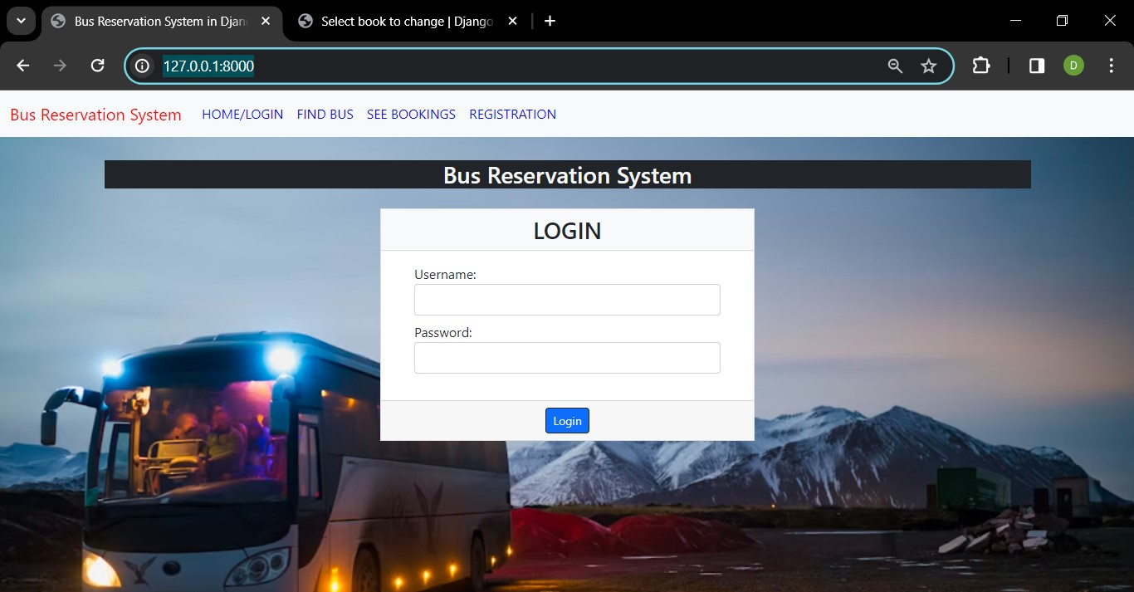
LOGIN PAGE

Slide 12
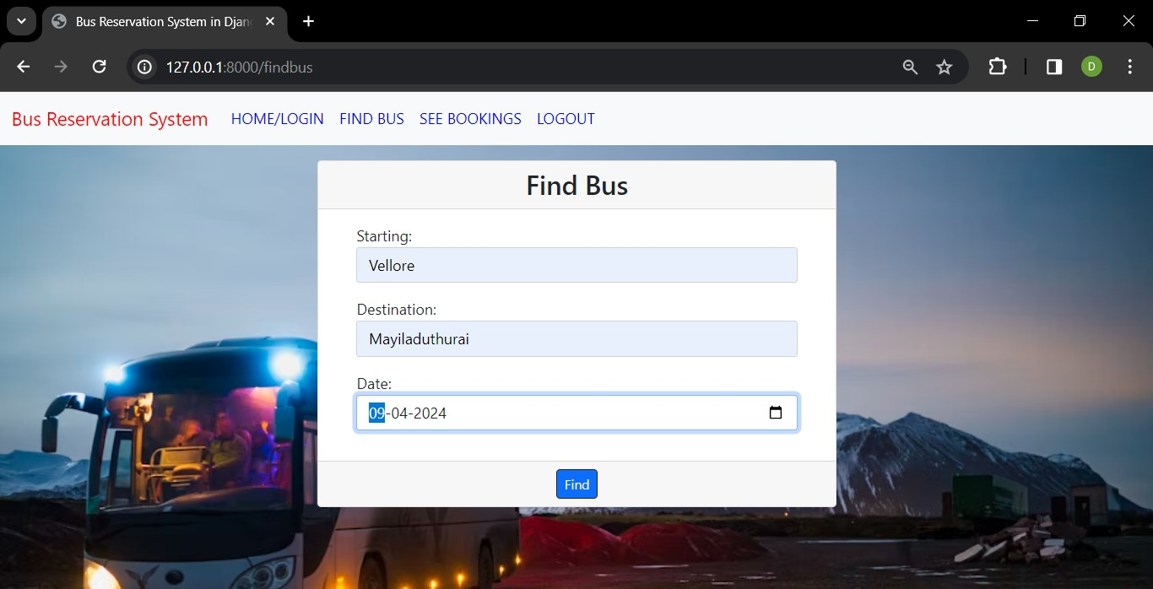
FIND BUS PAGE

Slide 13
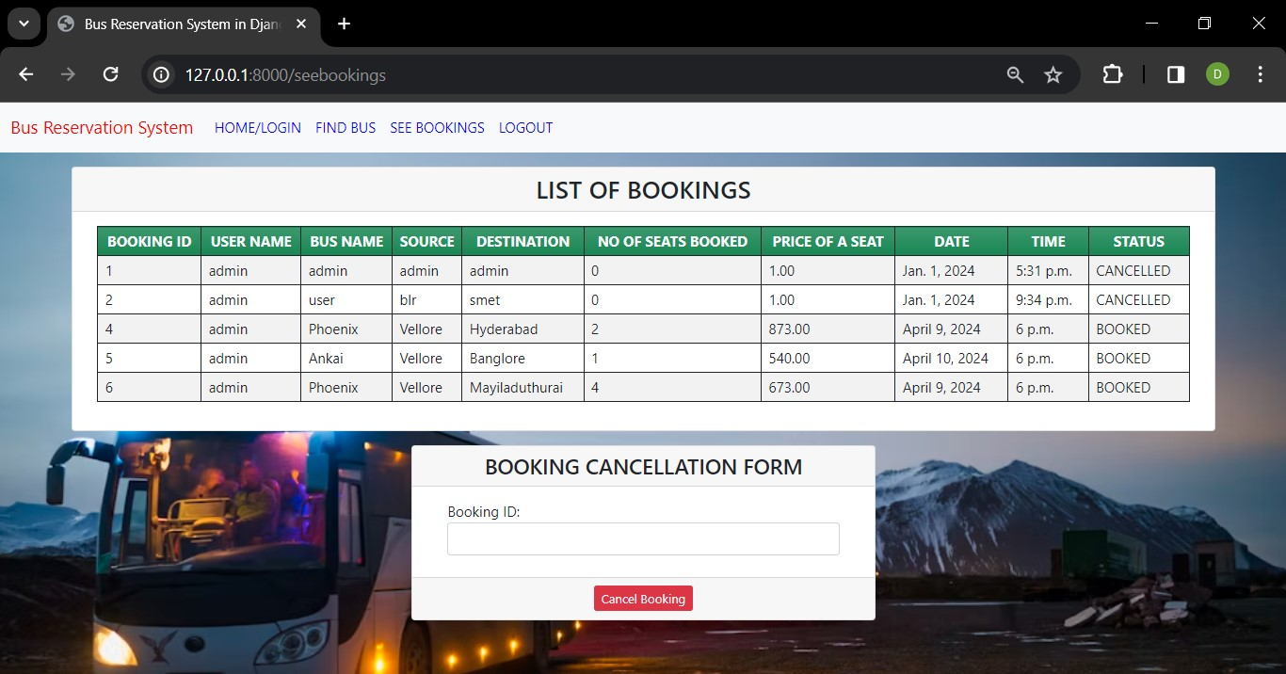
SEE BOOKINGS PAGE

Slide 14
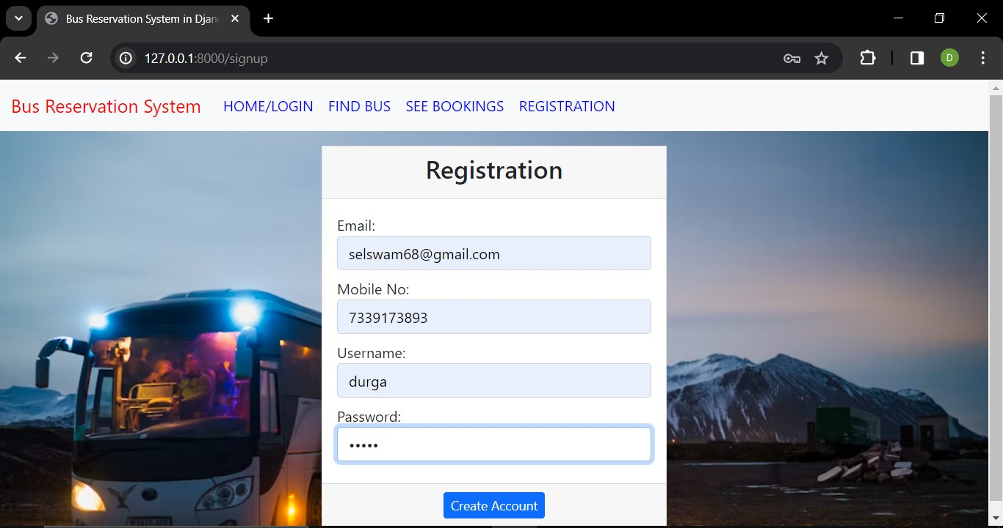
REGISTRATION PAGE

Slide 15
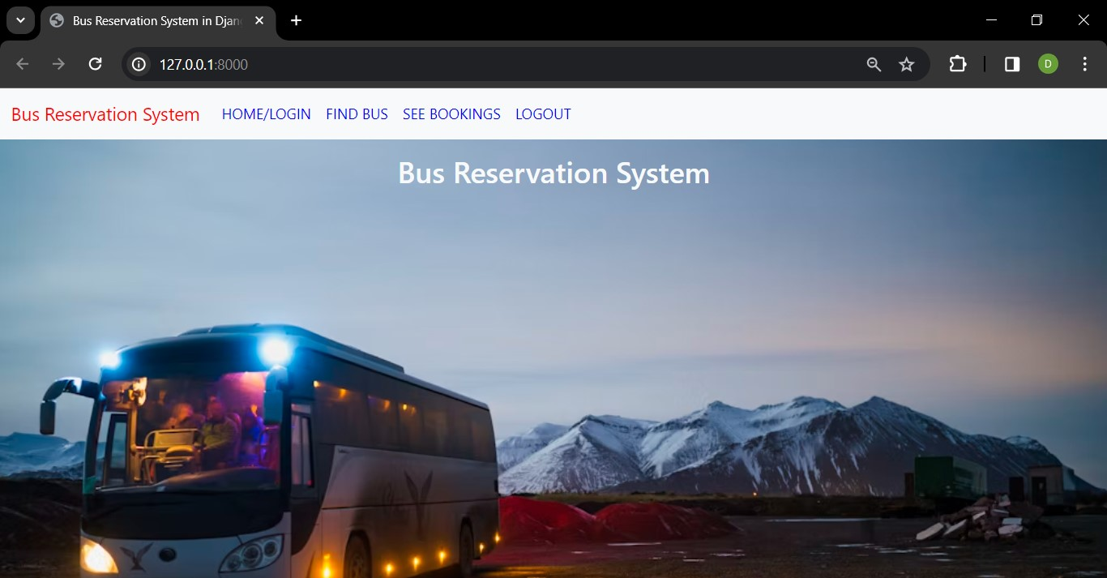
HOME PAGE

Slide 16
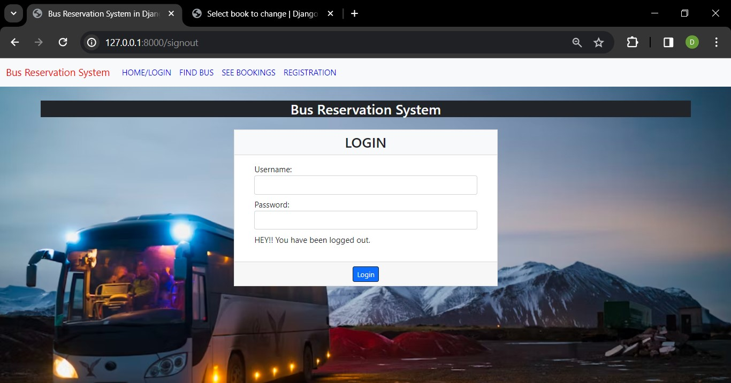
LOGOUT PAGE

Slide 17
Future Enhancements:
AI-Powered Route Optimization: Implement artificial intelligence algorithms to dynamically optimize bus routes based on real-time traffic data, weather conditions, and passenger demand, minimizing travel time and fuel consumption.
Augmented Reality Seat Selection: Introduce augmented reality features that allow passengers to visualize and select seats within the bus virtually, enhancing the booking experience and ensuring seating preferences are met accurately.
Predictive Maintenance: Utilize IoT sensors and predictive analytics to monitor the condition of buses in real-time, predicting maintenance needs and scheduling proactive repairs to minimize downtime and ensure fleet reliability.
Voice-Activated Assistance: Integrate voice-activated assistants or chatbots into the booking platform, enabling passengers to make inquiries, book tickets, and receive travel updates using natural language commands, improving accessibility and user engagement.

Slide 18
Conclusion
In conclusion, the bus reservation system serves as a pivotal solution in streamlining the booking process, enhancing passenger experience, and optimizing bus operations. Through its user-friendly interface, efficient booking management, and real-time updates, the system simplifies the journey for passengers while providing bus operators with tools to manage routes, seats, and schedules effectively.
As technology continues to advance, future enhancements such as dynamic pricing, AI-powered optimization, and augmented reality features promise to further revolutionize the bus reservation experience. These advancements not only improve convenience and efficiency but also contribute to environmental sustainability and customer satisfaction.
Overall, the bus reservation system represents a vital component of the modern transportation ecosystem, offering a seamless and reliable platform for travelers and operators alike. With continuous innovation and adaptation to evolving needs, it will continue to play a significant role in shaping the future of bus travel.
Source :

Slide 19
Thank You!
Notes:
Thank You !!

